Slide 1
hybrid cryptographic scheme (AES+RSA)
Author: Santiago Alzate Hurtado
Course: Practical Aspects of Modern Cryptography CIS5771
Instructor: Mehrdad Nojoumian

Slide 2
Content
What is a Hybrid cryptographic Scheme?
RSA implementation.
AES(pycryptodome Python library).
Hybrid implementation.
Demonstration.

Slide 3
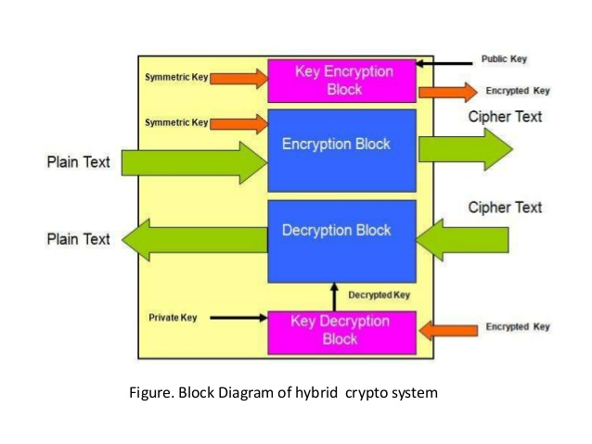
What is a Hybrid cryptographic Scheme?
A hybrid cryptosystem is one which combines the convenience of a public-key cryptosystem with the efficiency of a symmetric-key cryptosystem.

Slide 4
How does it work?
To encrypt a message addressed to Alice in a hybrid crypto-system, Bob does the following:
Obtains Alice’s public key.
Generates a fresh symmetric key for the data encapsulation scheme.
Encrypts the message under the data encapsulation scheme, using the symmetric key just generated.
Encrypt the symmetric key under the key encapsulation scheme, using Alice’s public key.
Send both of these encryptions to Alice.
To decrypt this hybrid cipher-text, Alice does the following:
Uses her private key to decrypt the symmetric key contained in the key encapsulation segment.
Uses this symmetric key to decrypt the message contained in the data encapsulation segment.

Slide 5
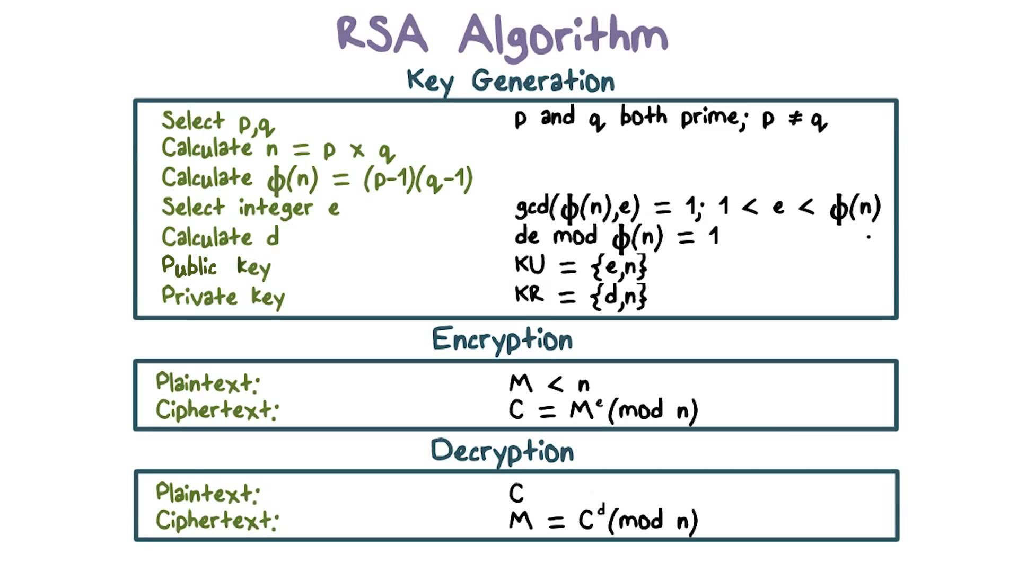
RSA Implementation

Slide 6
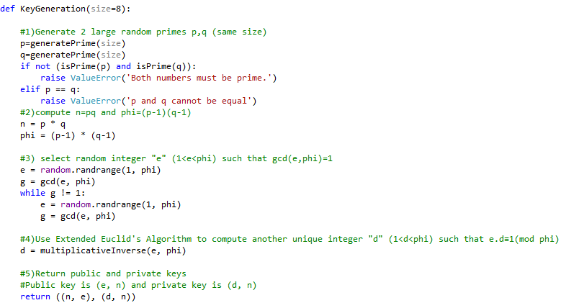
RSA Key Generator

Slide 7
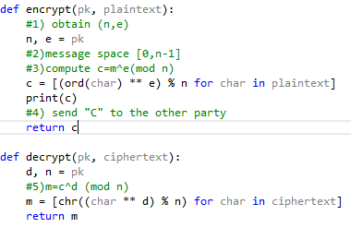
RSA Encryption and Decryption

Slide 8
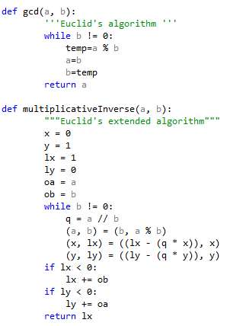
RSA Auxiliary Functions

Slide 9
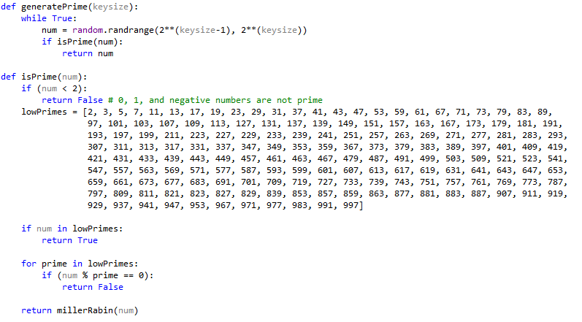
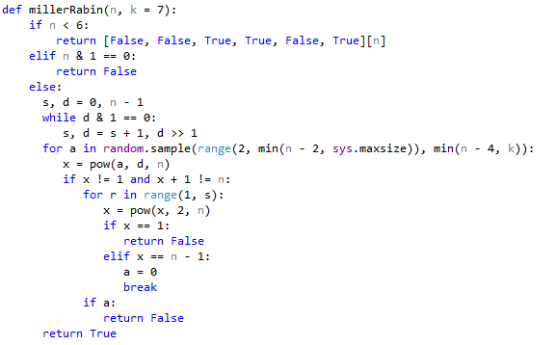
RSA Auxiliary Functions

Slide 10
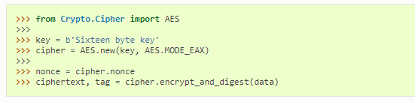
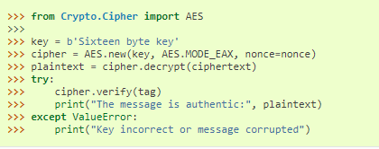
AES(pycryptodome Python library).
Encryption
Decryption

Slide 11
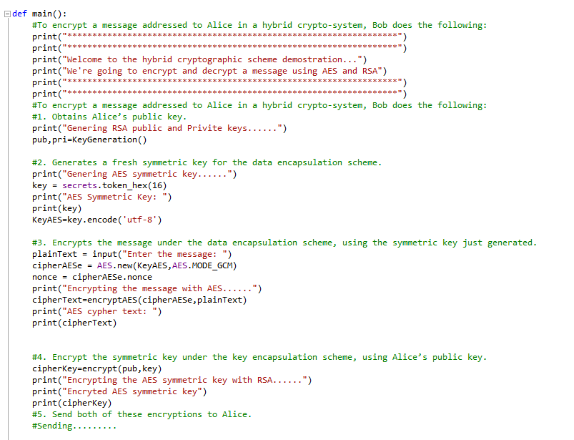
Hybrid implementation.

Slide 12
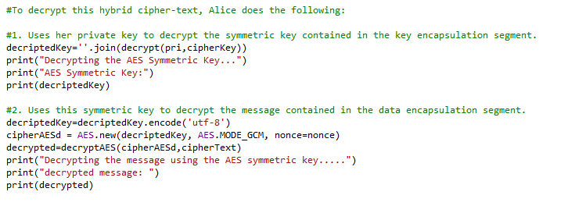
Hybrid implementation.

Slide 13
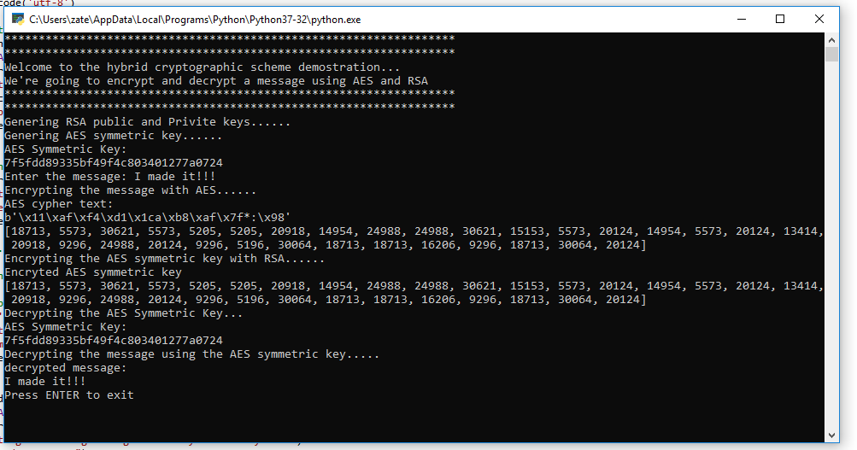
Demonstration

